Slide 1
Visioning Updates
Copyright © International Vision Facilitation Council 2020
Notes:
Jill - Intro

Slide 2
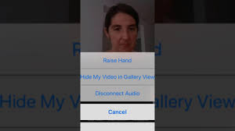
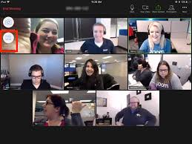
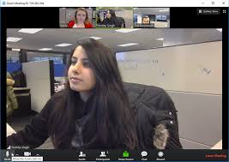
Rules of the zoom
Participants
Please activate your video webcam
Please remain muted until called upon
If using a phone for audio please self mute and unmute when called upon.
Utilize “chat” function
Utilize “raise hand” function
If the meeting is interrupted and ends, please wait 5 min and log in again
Gallery view will show all attendees
Speaker view will show current speaker and is view available on an Ipad or tablet
Desktop Control View
Tablet/Smartphone View
Copyright © International Vision Facilitation Council 2020
Notes:
Jill: go through normal Rules of Zoom
We are going to role model for you the opening where we get the participants familiar with the Zoom platform. You would say: In order to have an optimal experience with the Zoom venue, we recommend the following.
Stop SHARE

Slide 3
Poll
Have or are you doing in person/on site visioning since the pandemic began in February of this year?
Yes and continue
We have done some
No
No, but want to start again
Copyright © International Vision Facilitation Council 2020
Notes:
Welcome to all of you. One of the things we would like to start with is a poll to find out how many of you have been continuing with live on site Visioning so we are inclusive of those experiences as we share with you today. So, please respond to the following poll:
Have or are you doing in person/on site visioning since the pandemic began in February of this year?
Yes and continue
We have done some
No
No, but want to start again
(Do poll. Read the poll and choices.)
Though we are offering training for Virtual Visioning, we still support and applaud on site visioning. It works well for some clubs and members, it works easier for Districts that are geographically compact so facilitators do not have to travel, and someday this pandemic will come to a close and you will have to decide if you want to embrace it again. In the meantime, Virtual Visioning is a great tool, and it absolutely will help Districts that have geographical challenges.

Slide 4
The Process of Visioning
Status Assessment (Club Profile and Rotary Vision Questionnaire)
Writing exercise (Resource sheets)
Rules of the Zoom/Room & Introductions
PowerPoint Presentation
Extraction
Voting (2 rounds)
Summary
Master Plan
Action Plans
Vision to Success
Copyright © International Vision Facilitation Council 2020
Notes:
The process of visioning remains very similar to what it was when you went through training. The biggest change is that we recommend sending the writing exercise ahead of the event to free up time during the event to include an introduction to Action Plans and practice of same. We’ll drill into WHY later, but simply stated, we find that when members engage in the practice AT the visioning event, they are far more likely to have success with implementation afterwards.
Tonight we are going to go through a number of enhancements to our standard process, but the Virtual aspects of Visioning will be addressed in the next webinar.
Status Assessment (Club Profile and Rotary Vision Questionnaire)
Writing exercise (Resource sheets)
NEXT WEBINAR
Rules of the Zoom/Room & Introductions
PowerPoint Presentation
Extraction
Voting (2 rounds)
Summary
TODAY ALSO
Master Plan
Action Plans
Vision to Success
So let’s look next at a new resource that we are working on.

Slide 5
Email Resources
Confirmation - Club Sponsor, AG, Facilitation team
Writing exercise and resource sheets-Participants
Zoom Invitation –Participants, AG, Facilitation team
Two prep emails- Facilitation Team, AG
Copyright © International Vision Facilitation Council 2020
Notes:
One of our visioning chairs has kindly shared the email chain that he uses from beginning to end of the process. We are in working on getting these standardized and posted to the website for your use. As you can see On the Pre Event Slide, the content is listed, along with WHO the emails go to, and what attachments are included. (I will go through the list and tell a bit about content in each. note to self – the two prep emails are for the facilitation team. The completed club profile & RVQ in one, and the assignments for the team and links to practice vides in the other) Next the Post Event emails.

Slide 6
Email Resources: Post Event
Club Vision results – Club Sponsor, AG, Club President, person who volunteered to receive these
Voting results
PowerPoint template for club assembly
Post Visioning documents – Club Sponsor, AG, other volunteer
Includes Vision to Success Guide
Master /Action Plan templates
Copyright © International Vision Facilitation Council 2020
Notes:
(I will go through the list and tell a bit about content in each)
These emails have the critical information needed at each step and you will not be “reinventing the wheel” as you send out information. And, since they are in a word format, they can easily be adapted if there is something else that you would like to add.

Slide 7
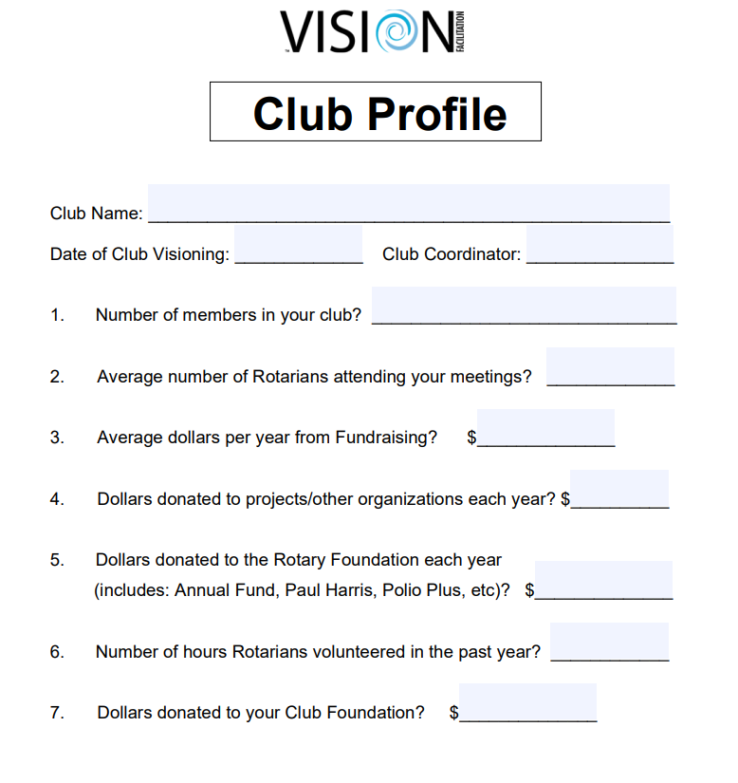
Club Profile
Copyright © International Vision Facilitation Council 2020
Notes:
Analytics are important, both for the club, but for also for the District and beyond. The Club Profile, filled out by the President or club liaison, is one of the analytics tools as well as used for creating a current baseline of the club. It asks seven measurable questions such as number of members, number of volunteer hours, dollars raised, etc. It is given again a year later to see any improvement in the club after achieving some of their goals. It is critically important that you get this before visioning and deploy one year later, then share with our Analytics team

Slide 8
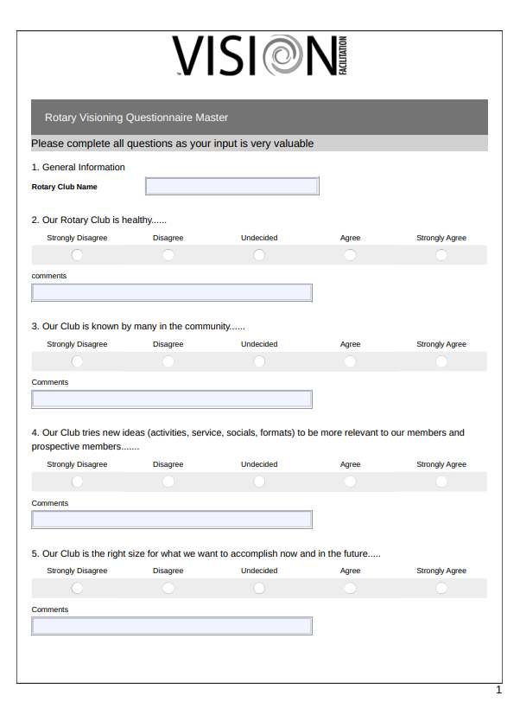
Rotary Visioning Questionnaire
Copyright © International Vision Facilitation Council 2020
Notes:
The RVQ or Rotary Visioning Questionnaire is a club survey that gives the leadership an idea about what the members think about their club at the present time. It is also used to get the club thinking about the areas that the writing exercise will address. It has one general question asking if the club is healthy and then eleven questions related to the areas we focus on in the writing exercise. It can also be used for analytics to see how the members’ views of the club have changed or not over time. It should be sent as a Survey Monkey to club members.

Slide 9
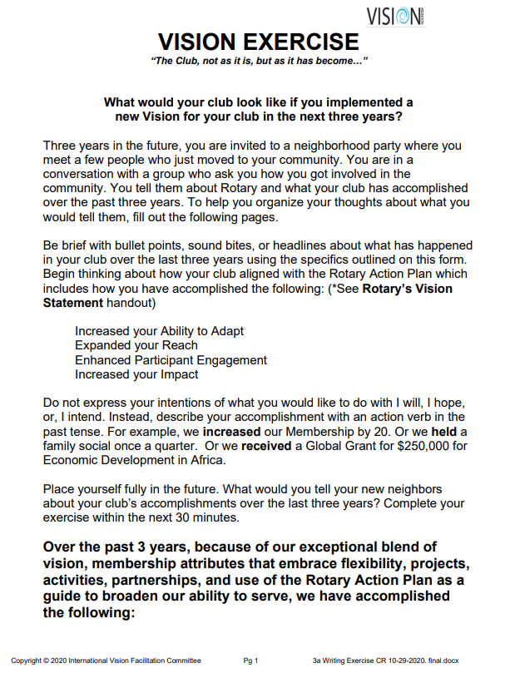
The Writing Exercise
Copyright © International Vision Facilitation Council 2020
Notes:
The Writing Exercise has been rewritten to be aligned with Rotary’s Action Plan. There is a section on each one of Rotary’s Action Plan priorities: Increasing our Impact, Expanding our Reach, Enhancing Participant Engagement, and Increasing our Ability to Adapt. As we said in the informational meeting, this is for a couple of reasons. First: These four areas in the RI Action Plan are the EPITOME of action! We want the clubs and their members to be thinking/posting/utilizing/engaging these four statements. Second: We have always felt that Rotary really becomes Rotary when members engage beyond the club. Our belief is that this is a way to connect members with Rotary International in a stronger form. And of course, we also add the areas that are familiar to you: Fundraisers and the Rotary Foundation and if applicable, their Club Foundation.

Slide 10
Resource Sheets
New Club Models
Foundation
RI Action Plan
Copyright © International Vision Facilitation Council 2020
Notes:
Along with the Writing Exercise, we send three resource sheets. We want club members to be familiar with the Rotary Action Plan as discussed on the last slide, so we send that along. We also send a copy of the New Club Models sheet that they might find useful in generating ideas and getting a broader understanding of what other clubs are doing to adapt and remain relevant in their communities. Information on the Foundation is also sent for newer members to get an overview, and for veteran members to be reminded of things like what Every Rotarian Every Year or Major Donor means.

Slide 11
Questions
Do you have any questions/comments about the revised:
1. Club Profile
2. RVQ
3. Writing Exercise & Resources
Copyright © International Vision Facilitation Council 2020
Notes:
We are going to pause now for any questions you might have. Please raise your hand in the participant function and I will call on you to unmute and ask your question or you may put your question in the chat box.

Slide 12
Creating a Master Plan
Create specific goals
Determine which goals will be accomplished over 3 years
Decide who will be in charge of each goal
Copyright © International Vision Facilitation Council 2020
Notes:
Of course during the event, the writing exercise is extracted and then the Summary/Synthesis highlighting the clubs top ideas is delivered with energy. After the club hears the summary in which all the top ideas are synthesized, they need to organize the ideas in some way. We suggest that they create a Master Plan that lays out the ideas/goals they want to accomplish over the next three years. Some ideas/goals will cover more than one year. Some ideas/goals will be postponed until the second or third year.

Slide 13
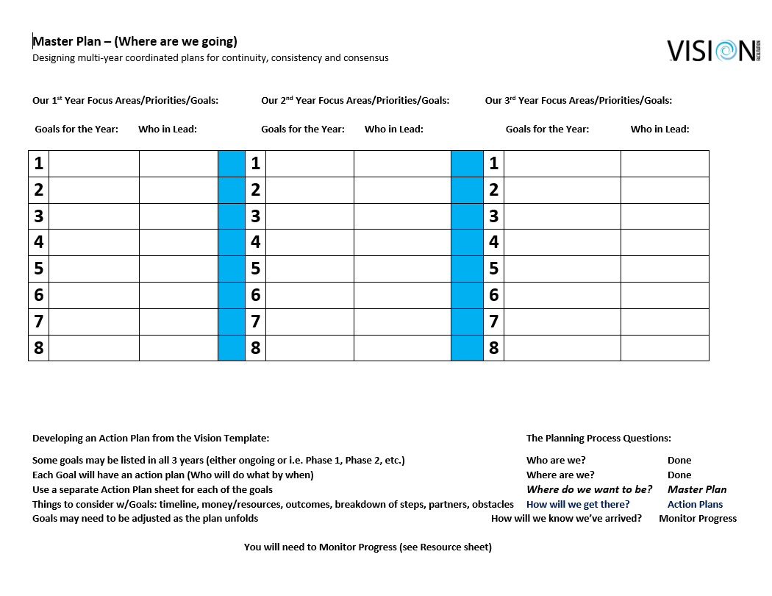
The Master Plan
Copyright © International Vision Facilitation Council 2020
Notes:
We then show them what the Master Plan looks like. We explain that in the upcoming weeks they will have a group that will be working to make recommendations about what ideas from the Visioning event will be inserted into year 1, year 2, and year 3 of the Master Plan. These ideas will then be discussed when the leadership shares the results with the club. We ask them to wait to fill out who will lead on the Master Plan until a goal has been developed for each idea when the Action Plan is developed. Let’s now look at how to create achievable goals.

Slide 14
Creating Achievable Goal
Examples of Achievable Goals:
Send two students to RYLA in 2021-2022
Increase our membership by 18 over three years
Write a Global Grant & have it approved by July 2022
Hold a joint fundraiser with another club in 2020-2021
Then decide who will be in charge of each goal.
Copyright © International Vision Facilitation Council 2020
Notes:
We want them to develop goals that are specific and have a time frame. We tell them that achievable goals mean that they define what they want to have happen in measurable terms. We show them the first example. We use sending two students to RYLA in the Rotary year 2021-2022 as a goal. This is a realistic goal which can be measured and has a timeline for its accomplishment. The next one is realistic, is measurable, and has a timeline: increase membership by 18 over three years. And as you read them, so are the Global Grant and the Fundraiser examples. All four of the goals are realistic, measureable and have a timeline. Later in our Vision to Success section, we will explain that you will develop a process for how you create the Master Plan.

Slide 15
Develop an Action Plan
Define the tasks that need to be accomplished to achieve the goal by stating who needs to do what by when.
Copyright © International Vision Facilitation Council 2020
Notes:
Once they know all about the Master Plan, then for each idea/goal on the Master Plan, they will need to create an Action Plan. We tell them that after developing the Master Plan, we suggest they develop an Action Plan for each idea/goal they created for year one. The Action Plan will define the tasks that they must accomplish in order to achieve the goal. Then once all the tasks are generated, they predict the outcome. Predicting the outcome allows them to answer the fifth planning questions which is: How will we know when we have arrived?

Slide 16
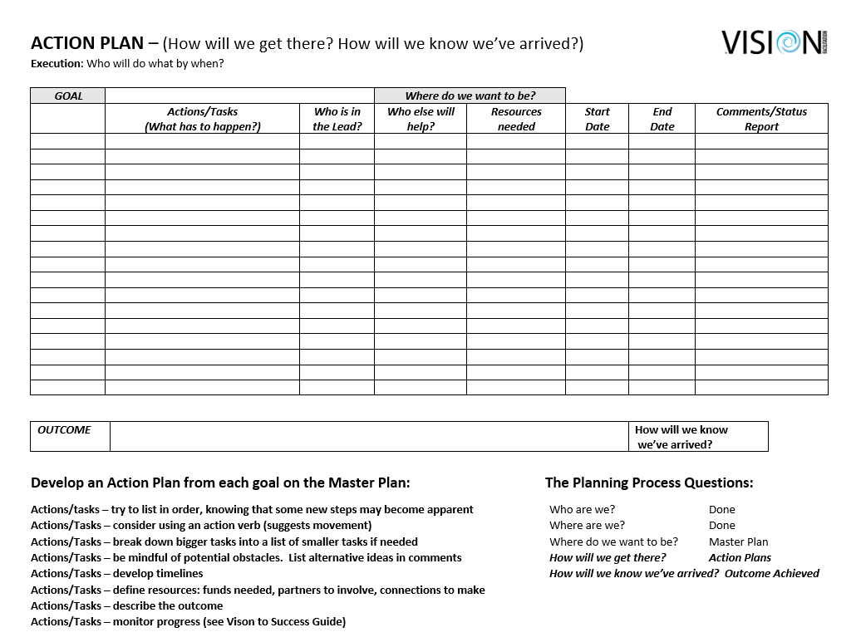
The Action Plan
Copyright © International Vision Facilitation Council 2020
Notes:
This is what the Action Plan looks like. It has the goal at the very top and then has a group of lines for all the tasks that need to be completed in order to achieve the goal. Additionally it asks, who needs to lead accomplishing that task? Who else will help with that task? Are there any resources required to accomplish that task? When will they start? When do they believe they will be done? And lastly, at the very bottom of the Action Plan, they predict what the outcome will be once they have accomplished that goal?

Slide 17
Action Plan Example
Goal: Send two students to RYLA in 2021-2022
1. What: Ask board to approve fee & appoint a RYLA chair
Who: Youth Services Chair
When: Next board meeting July 22, 2020
Resources: Check on fee and youth protection policy to share with board
2. What: Contact schools for possible candidates
Who: RYLA chair
When: Fall of 2020
Resources: None
3. (Perhaps 8-10 tasks to accomplish to make this goal a reality)
Copyright © International Vision Facilitation Council 2020
Notes:
It is very important to go over this slide as it gives them an example of what an Action Plan Example looks like. The Action Plan asks them to define who will do what by when. It asks what task needs to be accomplished. In the case of the goal of sending two students to RYLA, the first “what statement” is to ask the board to approve the fee to send two students to RYLA and to appoint a RYLA chair. Who will do that task? The Youth Services Chair needs to do that task since RYLA is a youth program. When will the task need to be accomplished? At the next board meeting on July 22 and be sure to specify the date. Will there be any resources needed for that task? Yes, they might need to check on the fee for RYLA and the Youth Protection Policy as the board might want to know those two pieces of information. We let them know it does not stop at one task. A goal might have 8-10 or more tasks before it is accomplished. So we suggest to them that they use one Action Plan form for each idea that they created on the Master Plan. We let them know that the President will get examples of both the Master Plan and Action Plan in the Vision to Success Guide.

Slide 18
The Process & Outcomes
Who are we?
Where are we?
Where do we want to be?
How will we get there?
How will we know when we have arrived?
Copyright © International Vision Facilitation Council 2020
Notes:
At the bottom of the Action Plan form, there is a box that says: Outcome. We tell them to use that box to answer the last planning question which is: How will we know when we have arrived. We tell them it is important to predict the outcome. If circumstances change, change the predicted outcome. It is a flexible and fluid document. In the example we used, we might say the outcome is having the two students who go to RYLA present at a club meeting.

Slide 19
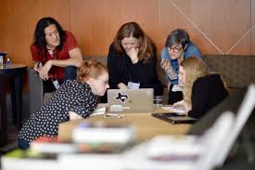
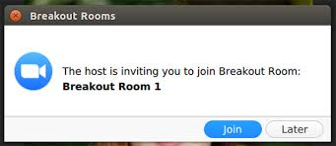
Action Plan Practice
Copyright © International Vision Facilitation Council 2020
Notes:
In learning theory, practicing what one has learned serves to ingrain the learning in the brain. So time is spent having the participants actually develop an Action Plan. This helps them to practice the skill they will need to achieve their vision.
In an on-site session they are broken into small groups. In a virtual session they are sent to “breakout rooms”. In each method they are given 15 minutes to practice creating an Action Plan for one of the goals the Facilitator has chosen out of their list of extracted ideas. When brought back together they have a brief chance to share the experience with each other as an entire group and to feel empowered with a clear expectation of what they will need to accomplish. The Vision to Success “volunteers” are much more eager to step up with having not only a practice session, but also, witnessing the enthusiastic participation of their fellow club members in that process.

Slide 20
Breakout: Creating Action Plans
You will be given one vision as defined today
Develop it into an achievable goal
Define the tasks needed to accomplish the goal
Determine who needs to do the task
Establish resources needed to achieve the task
Decide when the task needs to be accomplished
Predict the outcome that will be achieved when you successfully accomplish the goal
Copyright © International Vision Facilitation Council 2020
Notes:
This slide explains how the practice session will work.
If on-sight you say:
Now we are going to give you the opportunity to practice creating an Action Plan. I have chosen one of your top ideas and have created an achievable goal for you to use. (Already have one created so you don’t have to do it on the fly.)
Here is an Action Plan document for you to use. (Pass out the document.) I will put you in groups and I want you to make an Action Plan for the goal I will tell you once you have gotten into your groups. (Put them in groups.) As you get into your groups, please choose a reporter. (Then read the goal to them. Give them 15 minutes to generate an Action Plan for that goal. Then have several of them read their Action Plan tasks.)
If virtual and the way we will do it today, you would say:
Now we are going to give you the opportunity to practice creating an Action Plan. I have chosen one of your top ideas and have created an achievable goal for you to use. (Already have one created so you don’t have to do it on the fly.)
You will be sent to the breakout rooms automatically. You will use the Action Plan form that was e-mailed to you or grab the one in the chat box to download to your computer right now. Here is the goal: (state the achievable goal.) Please use the Action Plan form and create an Action Plan for that goal. Choose a reporter to share your Action Plans when you return to the main room. Are there any questions? (Answer any questions.) Please send everyone to the breakout rooms. (Send them automatically to the breakout room and bring them back after 15 minutes with a one minute warning.)
(Be in gallery view when returning.) Reporters for each group, please raise your hand in the participant function and I will call on you to unmute and share your Action Plan for the goal you were assigned. (Call on as many groups as time permits.)
Transition: ________ will walk you through the next steps which we call Vision to Success. (Scribe writes on an electronic document for Vision to Success.)

Slide 21
Questions
Are there any questions about these two new documents?
Master Plan
Action Plan
Copyright © International Vision Facilitation Council 2020
Notes:
We are again going to pause now for any questions you might have. Please raise your hand in the participant function and I will call on you to unmute and ask your question or you may put your question in the chat box.

Slide 22
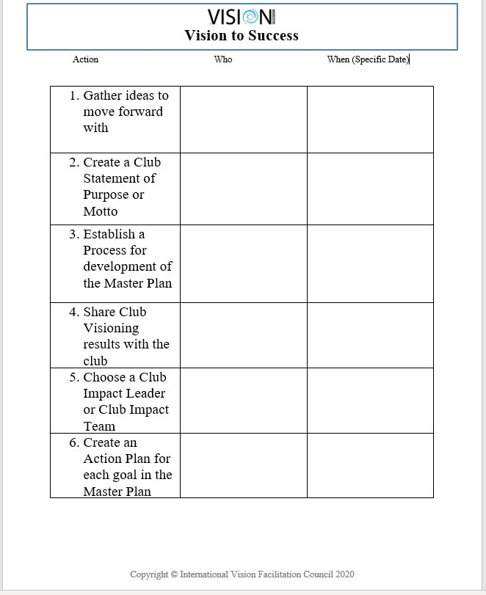
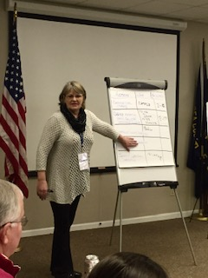
Vision to Success
Copyright © International Vision Facilitation Council 2020
Notes:
As we mentioned on the informational webinar, this slide used to simply be called Next Steps. We have adapted this to include next steps, but also to include the very important step: SUCCESS!
If on-site: You would use the newsprint to ask for volunteers to perform the next steps which we call Vision to Success.
If virtual: You would use a Word Document to capture the information about volunteers to perform the next steps which we call Vision to Success.

Slide 23
Vision to Success
1. Gather ideas to move forward with
2. Create a Club Statement of Purpose or Motto
3. Establish a Process for development of the Master Plan
4. Share Club Visioning results with the club
5. Choose a Club Impact Leader or Club Impact Team
6. Create an Action Plan for each goal in the Master Plan
Copyright © International Vision Facilitation Council 2020
Notes:
This slide explains the next steps and asks for volunteers to commit to helping the club President achieve the ideas that were generated in the Visioning.
GO TO VISION TO SUCCESS TEMPLATE
Let’s see who is going to help with the next steps which we call Vision to Success.
1. If on-site: (Scribe writes on the newsprint.) One of you will need to compile the wall charts, recording all of the information, then recording perhaps your top three choices which become the basis of your Master Plan. We have an excel template to send to you in order to compile the ideas. Who would be willing to take the wall charts? (Get someone to volunteer.) By when will you have them compiles on the excel spread sheet?
1. If virtual: (Scribe uses an electronic form for participants to see.) Your top ideas in each area become the basis of your Master Plan. Who will get the list of ideas compiled by the scribe? (Get someone to volunteer.) We will send those to you as soon as possible.
2. Next you will create YOUR club’s Statement of Purpose, motto, tagline, slogan or whatever feels right to you. Often this comes from the questions about: What does your club Stand for and What are your Club Attributes. Typically this is done with a committee of about 5 that brings a recommendation back to the club as to what your motto will be. Who would be willing to lead this committee? (Get a volunteer.) Who will help ______ with this? (Get 4-5 volunteers.) When will you meet for the first time?
3. You will need to decide how to develop a process for generating the Master Plan using each of the top ideas. This is different for every club, but certainly can be done with your existing committees and/or those of you here at the Visioning. This committee will develop a process for creation of the Master Plan. Who wants to be on the committee to generate the process by which the Master Plan will be developed? (Get 4-5 volunteers.) When will you have that process generated?
4. Now you need to engage the club in what has happened in order to get a collaborative commitment. Likely they will have heard about the Visioning event and will be excited to hear what has happened. Remember that you came to this event as a group, so this presentation should be done as a group. If a number of you are sharing, this will help engage the rest of the club. We have a PowerPoint template for you to use to describe what Visioning is all about and the results of the Visioning. Who wants to help your President present to the club? (Get 4-5 volunteers.) President _______, when would be a good time to share the results of the Visioning with your club?
5. Would one person or a group of you be willing to be the Impact Leader or Club Impact Team, not DOING everything, but making sure the club keeps moving forward with this vital work? (Get one volunteer or a group of volunteers.) Of course, the champion’s or team’s job will be for the next three years on a continual basis.
6. If virtual: (Go back to the PowerPoint.) If on-site: (Just point to the PowerPoint.)
You have a Master Plan with goals to accomplish over the next three years. Now you need to have a process by which the Action Plan for each of those goals will be created? We encourage you to give this task to your committees after presenting the results. When a committee generates its own plan, it is more likely to follow through with the plan.
In addition, we have our new Vision to Success Guide for the club which will be sent to the President.
CHANGE SCREEN TO V2S form
As you can see as Jill scrolls over it, each of the assignments gets a deeper dive here to help remind the club of the information that was shared at the event about each of these steps, hearing again what was just said, but adding MORE helpful information. It has additional ideas for how to keep the plan alive, share the plan, both inside and outside of the club, a critical part of successful execution. It has examples of a completed Master Plan and Action Plan. This was just piloted with a District and the feedback from the Chair that the first club found it very helpful. He then shared the Guide with his team of facilitators, and they were so excited that they are in the process of sending it out to the last 5 clubs that had a facilitation event!
As you coordinators and facilitators utilize the guide, please gives us input on other ways you have seen, or used, or thought would work to ensure the clubs success in the implementation stage. Please send any ideas to Rita or me.
After everything is developed, be sure to send the Master Plan to your Assistant Governor and your District Governor so they can support you in your process of achievement.
If on-site:
Give them the evaluation form and have them fill it out.
If virtual:
We would like to do a Poll to get some feedback from you. There are four questions. Please chose an answer for the first question and then submit. Then do the same for the other three questions.

Slide 24
Questions
Are there any questions about helping them get organized to implement the ideas that they created at the Visioning event?
Copyright © International Vision Facilitation Council 2020
Notes:
We are going to pause now for any questions you might have. Please raise your hand in the participant function and I will call on you to unmute and ask your question or you may put your question in the chat box.

Slide 25
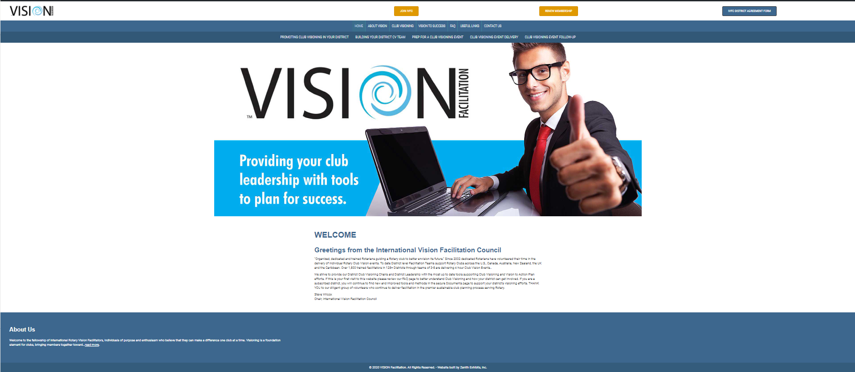
Website How to find docs
https://rivisionfacilitation.org/
SUMMARY
STATUS ASSESSMENT
WRITING EXERCISE
PLANNING DOCUMENTS
VISION TO PLAN SUCCESS GUIDE
Copyright © International Vision Facilitation Council 2020
Notes:
Jill:
So, tonight we looked at the Status Assessment (Club Profile and Rotary Vision Questionnaire), Writing exercise (Resource sheets) and our planning documents: the Master Plan, Action Plan, and Vision to Success Guide. In addition, we talked about the email chains, which should be on the website in early December.
STOP SHARE GO TO LIVE WEB
We are very excited about all of these resources being available to you on the website. This is the first and foremost place to look for resources and information is at the website. As you can see, when you are logged in the resources are found under Promoting in your District, Building your team (being developed), AND, where you will find the resources that we looked at today: Prep for a Visioning Event, Event Delivery, and Event Follow-up.
If you are a District Coordinator, you either have a login or hit Join IVFC. If you are a facilitator, please contact your District Coordinator for resources. We will be continuing to add resources for you to use, so please continue to look here for updates.

Slide 26
Poll
We would like more skills training for our facilitators:
PowerPoint Presenter
Facilitator/Extractor
Scribe
Summarizer/Synthesizer
Planner
All of the above
Copyright © International Vision Facilitation Council 2020
Notes:
Rita
As we move forward with trying to build out training pieces, especially in this new Virtual world we are operating in it is important to find out how we can be of assistance to you. In this next poll, we’d like to know what kind of training you need help with. Please indicate on the poll.
AFTER POLL: Thank you. Please don’t hesitate to give us more feedback if you have thoughts.

Slide 27
Questions
What excites you about what you have seen today?
What concerns you?
Copyright © International Vision Facilitation Council 2020
Notes:
These are two questions that we ask at the end of a Visioning so we want to ask them to you tonight too. Please raise your hand in the participant function and I will call on you to unmute and respond.

Slide 28
Upcoming Session
Deep Dive into Doing a Virtual Delivery
When: December 3, 2020
Time: 6pm CT (7pm ET)
Where: Zoom Registration link
Copyright © International Vision Facilitation Council 2020
Notes:
Jill: Our next deep dive is something we know you still have questions about, and that’s how to set up and conduct a Virtual Club Visioning Facilitation. Please register to attend December 3 at 6p central and I have just put that link in the chat box

Slide 29
Thank You
For your participation and good luck with helping clubs achieve their potential through Visioning
Copyright © International Vision Facilitation Council 2020
Notes:
Jill: We want to thank you for being committed to helping clubs learn a process which can help them be more dynamic and engaging. Remember, the club does not know the process so even if you miss a part or mess up, they will have no idea it happened. Practice your part over before you go to the Visioning event and you will do just fine. If it is to be a virtual Visioning, an absolute must is the Tech Rehearsal. We wish each of you good luck in your facilitation journey. And thank you to your Governor Line for bringing Club Visioning to your District.

